Slide 1


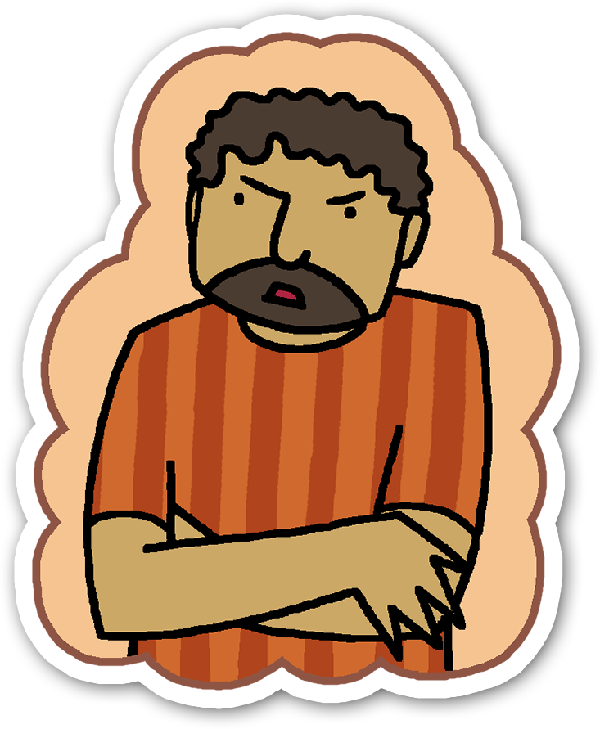
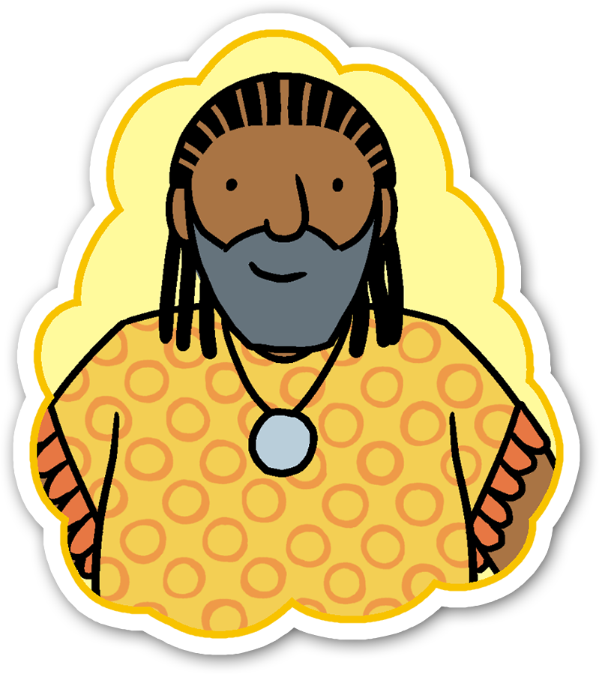

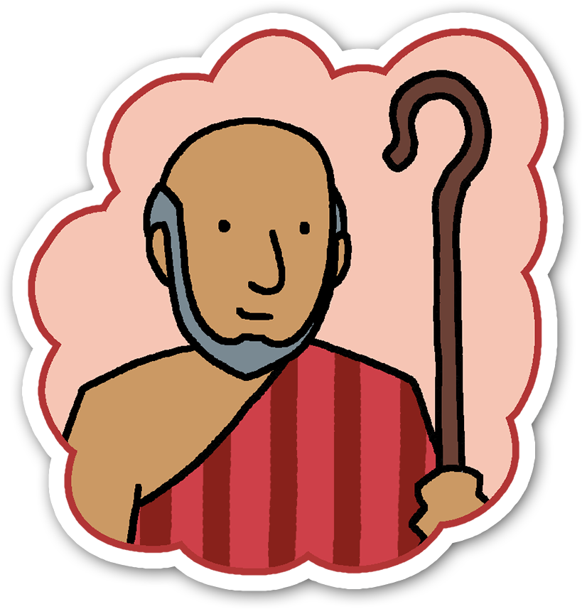
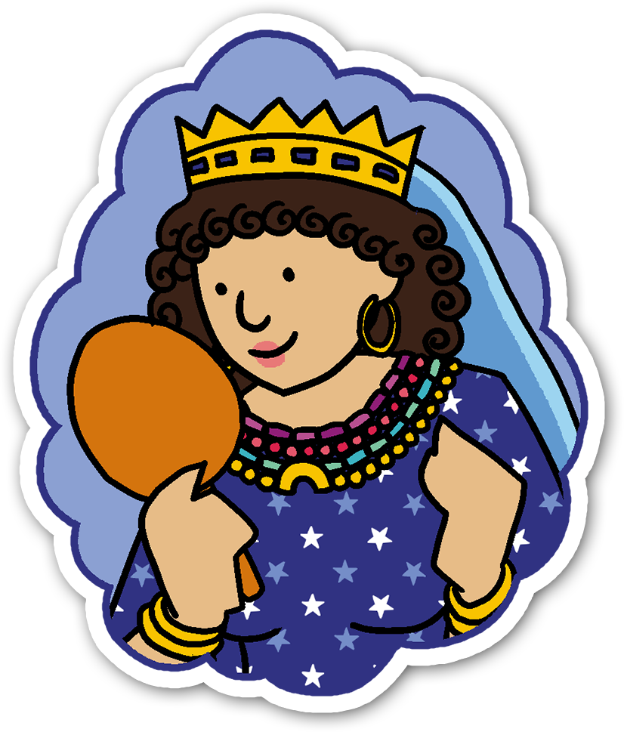



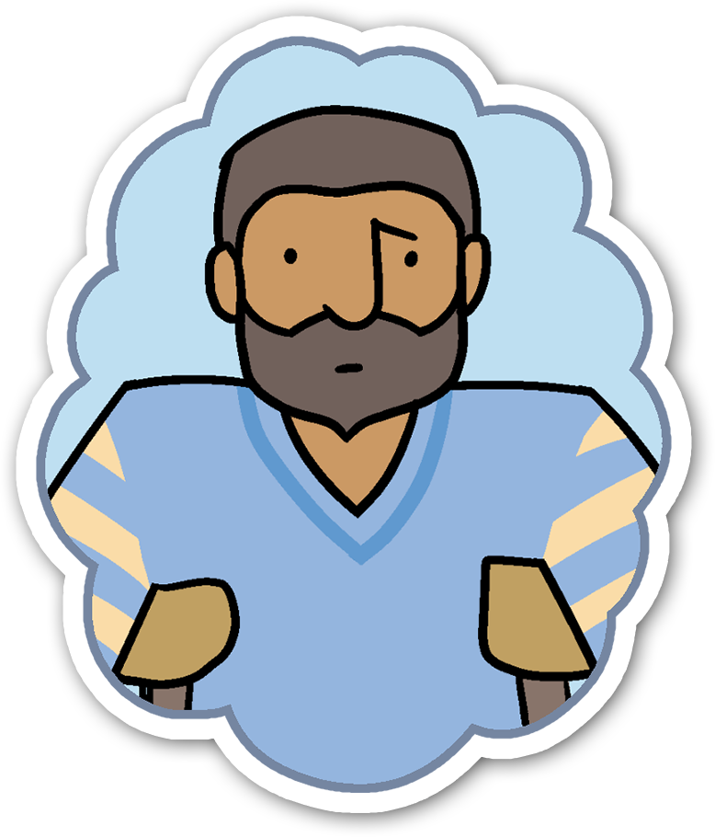

4 phase model
Overview
Input
Processing
Review

Slide 2


Lesson 1: The Bible
I am developing respect for others and my understanding of their beliefs and values. RME 0-07a
I use signs, books or other texts to find useful or interesting information and I use this to plan, make choices or learn new things. LIT 0-14a
Learning Intention: To find out that the Bible contains different types of books, which tell us the stories of real people who believed in God.
Success Criteria: I can tell you one fact about the Bible.

Slide 3
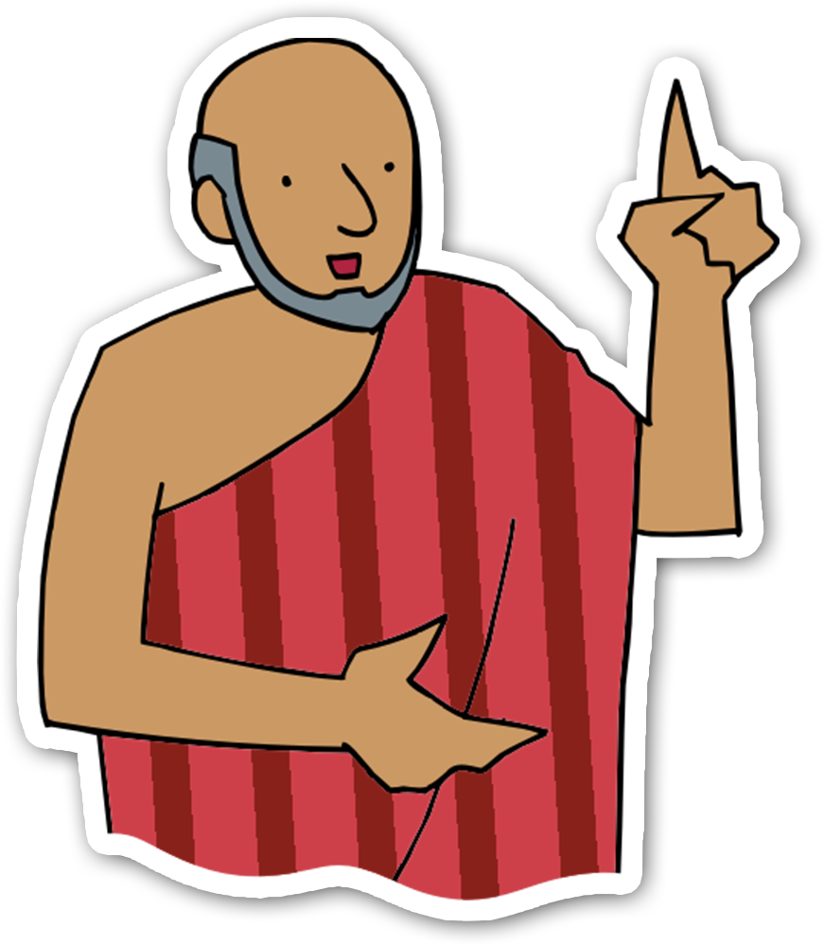
Lesson 2: Moses
Through exploring Bible stories, I can describe some beliefs Christians have about God and Jesus. RME 1-01a
As I play and learn, I enjoy exploring interesting materials for writing and different ways of recording my experiences and feelings, ideas and information. LIT 0-21b
Learning Intention: To consider a key event in Moses’ life and decide if I am similar to Moses or not.
Success Criteria: I can identify similarities and
differences between myself and Moses.

Slide 4

Lesson 3: Ruth
I can show my understanding of values such as caring, sharing, fairness, equality and love. RME 1-09b
I am learning skills and strategies which will support me in challenging times, particularly in relation to change and loss. HWB 0-07a
Learning Intention: To explore, through the story of Ruth, how different places and life events can affect emotions.
Success Criteria: I can connect facial expressions to
emotions and life experiences.

Slide 5

Lesson 4: Mephibosheth
Having explored biblical and other Christian stories, I can show my developing understanding of key values of Christianity and how they might be put into action in people’s lives and communities. RME 1-02a
By exploring and observing movement, I can describe what I have learned about it. HWB 0-24a
Learning Intention: To understand that we can show kindness to others.
Success Criteria: I can promote kindness and consider
how to be kind to myself and others.

Slide 6
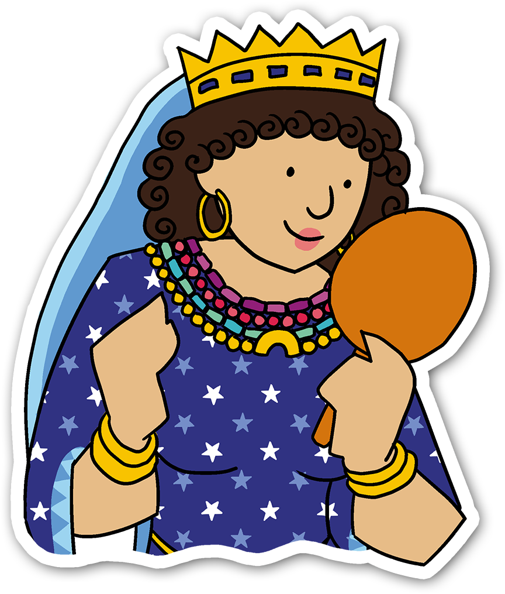
Lesson 5: Esther
I am discovering how followers of world religions demonstrate their beliefs through prayer/
meditation, worship and special ceremonies. I am developing respect for the practices and traditions of others. RME 1-06a
I am aware of and able to express my feelings and am developing the ability to talk about them. HWB 0-01a
Learning Intention: To explore what it means to be beautiful and what it means to be brave. To understand that prayer is used to help Christians.
Success Criteria: I can express something beautiful
about myself and I can create a prayer.

Slide 7
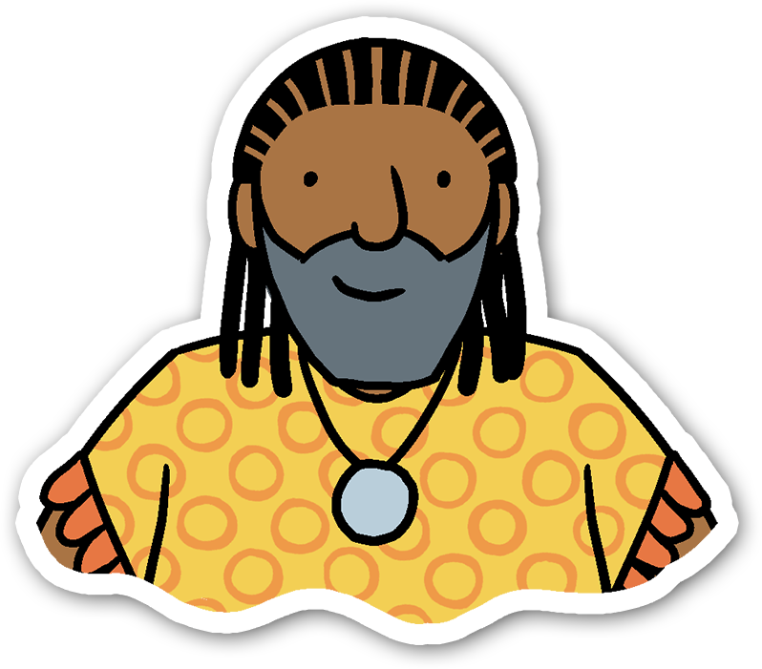
Lesson 6: Job
As I explore Christian stories, images, music and poems, I am becoming familiar with some beliefs Christian people have about God and Jesus. RME 0-01a
I understand that my feelings and reactions can change depending upon what is happening within and around me. This helps me to understand my own behaviour and the way others behave. HWB 0-04a
Learning Intention: To explore the story of Job and see that he experienced suffering. To understand that in life there are different experiences of suffering but they do end.
Success Criteria: I can describe how Job responded to
suffering. I can respectfully share my own thoughts about suffering.

Slide 8
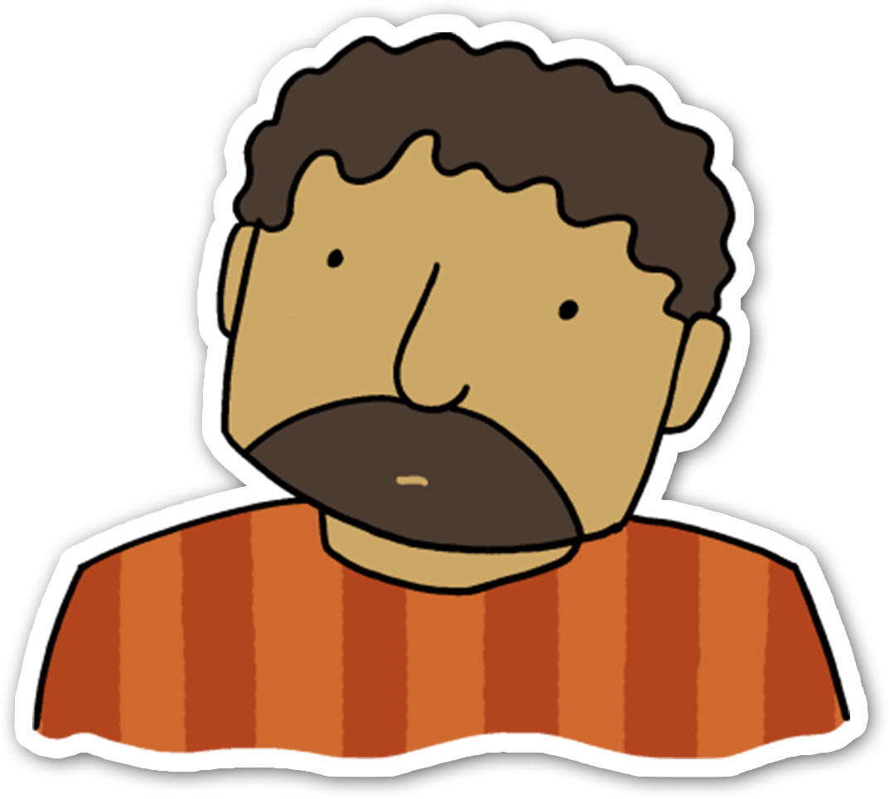
Lesson 7: Jonah
I can describe the key features of the values of Christianity which are expressed in stories. RME 1-02b
I can use appropriate vocabulary to describe the likelihood of events occurring, using the knowledge and experiences of myself and others to guide me. MNU 1-22a
Learning Intention: To explore the Christian belief that God loves to give second chances.
Success Criteria: I can create a fidget to help me. I can
compare myself to Jonah.

