Slide 1
SU Scotland International Project
4 WHEELS FOR RWANDA

Slide 2
1. What is Rwanda known as? ‘The Land of…
B: …a thousand hills’
A: … a thousand the roads’
C: …a thousand coffee beans’
D: …a thousand potholes’

Slide 3
2. The population of Rwanda is?
A: 3.5 million people
B: 8.5 million people
C: 11.2 million people
D: 20.5 million people

Slide 4
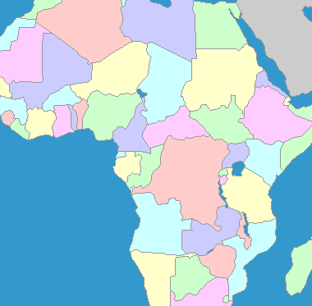
3. Where in Africa is Rwanda?
A
B
C
D

Slide 5
4. How big is Rwanda compared to Scotland?
A: Twice the size of Scotland.
B: A quarter of the size of Scotland.
C: Three times the size of Scotland.
D: A third of the size of Scotland.

Slide 6
5. In 2007, Rwanda was the first country in the world to legislate a ban on what?
A: Smoking
B: Plastic Bags
C: Chewing Gum
D: Plastic Cutlery

Slide 7
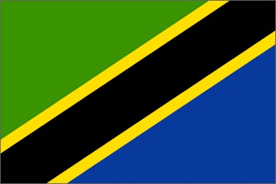
6. Which is the flag of Rwanda?
A
B
C
D
Notes:
A = Tanzania
B = Gabon
C = Rwanda
D = Ukraine

Slide 8
7. Why are we raising money for a 4x4 for Rwanda?
A: Because there roads are in poor conditions.
B: Because they need more vehicles to transport staff.
C: Because their minibus has broken down.
D: Because they need a car with SatNav.

Slide 9
8. How much do we need to raise for a 4x4 for Rwanda?
A: £10,000
B: £15,000
C: £12,000
D: £16,000

Slide 10
Thanks for helping us give 4 Wheels for Rwanda!

