Slide 2
Joshua 1:9 (CEV)
I’ve commanded you to be strong and brave.
Don’t ever be afraid or discouraged!
I am the Lord your God, and I will be there to help you wherever you go.

Slide 3
Lord God, how awesome you are!
You flung the stars into space. You made the mountains and the sea, and you made us.
Thank you that you pour your love upon us. Thank you that you care for us as a Father loves his children. Thank you that you promise to be with us.
Lord God, we are really thankful.

Slide 4
We thank you for the summer holidays.
We thank you for time outdoors exploring your wonderful creation.
We thank you for time spent with family and friends.
Lord God, we are really thankful.

Slide 5
Forgive us when we forget to thank you.
Forgive us when we ignore you and shut you out.
We remember that friendship with you came at a cost – the cost of your giving Jesus, your one and only Son.
Lord God, we are really thankful.

Slide 6
We thank you for Jesus, for his death and resurrection, and his victory over sin and death.
Lord, we worship you. You are our God, and we are your children.
Help us to listen to what you want to say to us today.
Amen.

Slide 7
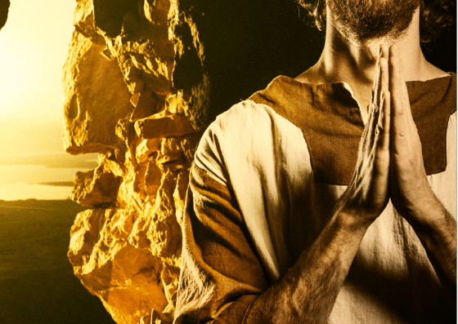
Joshua 1:1-9 (CEV)
Moses, the LORD’s servant, was dead. So the LORD spoke to Joshua son of Nun, who had been the assistant of Moses.

Slide 8
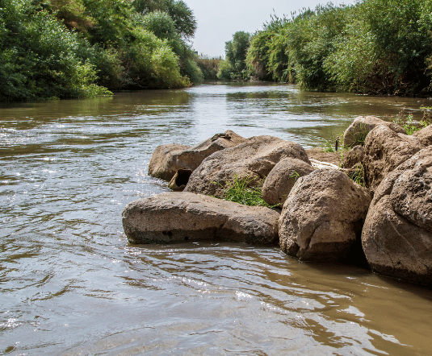
The LORD said: “My servant Moses is dead. Now you must lead Israel across the Jordan River into the land I’m giving all of you.

Slide 9
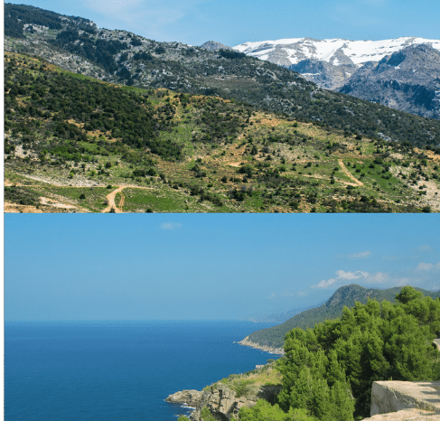
Wherever you go, I’ll give you that land, as I promised Moses. It will reach from the Southern Desert to the Lebanon Mountains in the north, and to the northeast as far as the great Euphrates River. It will include the land of the Hittites, and the land from here at the Jordan River to the Mediterranean Sea on the west.

Slide 10
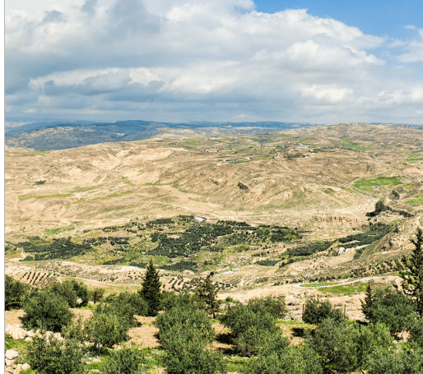
Joshua, I will always be with you and help you as I helped Moses, and no one will ever be able to defeat you.
Long ago I promised the ancestors of Israel that I would give this land to their descendants. So be strong and brave!

Slide 11
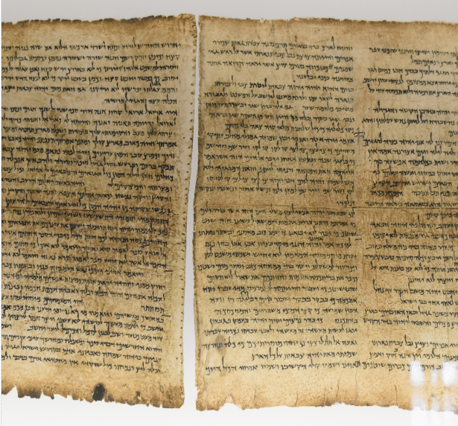
Be careful to do everything my servant Moses taught you. Never stop reading the Book of the Law he gave you. Day and night you must think about what it says.
If you obey it completely, you and Israel will be able to take this land.

Slide 12
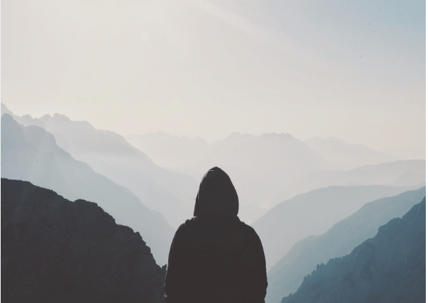
I’ve commanded you to be strong and brave. Don’t ever be afraid or discouraged! I am the LORD your God and I will be there to help you wherever you go.

Slide 13
Joshua 1:9 (CEV)
I’ve commanded you to be strong and brave.
Don’t ever be afraid or discouraged!
I am the LORD your God, and I will be there to help you wherever you go.

Slide 14
Say together:
Because God is with us, we can be strong and brave.

Slide 15
Joshua 1:9 (CEV)
Don’t ever be afraid or discouraged!
I am the LORD your God, and I will be there to help you wherever you go.

Slide 16
Chat together:
Can you think of a time when you faced change at school or home or work? Maybe a new baby, a new job, a house move? How did knowing God was with you help you be strong and brave?

Slide 17
Joshua 1:9
I’ve commanded you to be strong and brave.
Don’t ever be afraid or discouraged!
I am the LORD your God,
and I will be there to help you wherever you go.

Slide 18
Say together:
Because You are with us, we can be strong and brave!

